Slide 1
Demystifying the World Heritage System Mona O’Rourke
Conventions, Declarations, Regulations and other initiatives of UNESCO
UNESCO’s Venice Charter 1964
ICOMOS was established in 1965
Venice Charter principles form basis for policy in relation to assessment of World Heritage

Slide 2
World Heritage System
Concept that human history is the heritage of all humanity
Processes are evolving to reflect development of conservation approaches
Co-operative efforts to protect natural areas and historic sites
The Convention concerning the protection of World Cultural and Natural Heritage 1972 (known as the World Heritage Convention)
One of UNESCO’s most successful programmes for heritage preservation is the evolving regime under the World Heritage Convention

Slide 3
World Heritage Centre, Paris
Secretariat to the World Heritage Committee
World Heritage Committee made up of 21 States Parties elected for up to 6 years
World Heritage Centre organises the annual sessions of World Heritage Committee
Updates the World Heritage List and database
Co-ordinates reporting on condition of sites and emergency action where threatened

Slide 4
States Parties to the Convention
167 States parties and Ireland ratified the Convention in 1991
Agree to identify and nominate properties in their national territory to be considered for inscription on the World Heritage List
States Party gives details of how a property is protected and managed when nominating
States Parties are expected to protect the ‘Outstanding Universal Value’ of the properties inscribed and are encouraged to report periodically on their condition

Slide 5
Tentative Lists
properties which the State Party intends to consider for nomination to the World Heritage List
a Tentative List Submission Format, containing the name of properties, their geographical location, a brief description, and justification of their Outstanding Universal Value.

Slide 6
World Heritage Convention
Defines “Cultural Heritage” at Article 1 : it includes “monuments”, “groups of buildings” and “sites” each of which are further defined
the [World Heritage] Committee shall establish, keep up to date and publish, under the title of “World Heritage List” which it considers as having Outstanding Universal Value in terms of “such criteria as it shall have established”
https://whc.unesco.org/en/list/

Slide 7
Concept of Outstanding Universal Value
WH Convention does not define OUV
Operational Guidelines (OGs) provide the 10 criteria upon which a determination is made whether a property has OUV or not
OUV means cultural and/ or natural significance which is so exceptional as to transcend national boundaries and to be of common importance for present and future generations of all humanity…
Statement of Outstanding Universal Value (SOUV) comprises factual information, justification for the criteria from the Ogs, Statement of Integrity, Statement of Authenticity, Requirements for protection and management of the site
The interpretation of OUV is the sum of these parts

Slide 8
Attributes and Values
Attributes are aspects which convey or express the OUV of a WHS and which contribute or enhance understanding of the Outstanding Universal Value
The purpose of identifying them is so they can be protected managed and monitored
They need to include the valued characteristics which convey the values identified in the Statement of Outstanding Universal Value (SOUV)
OGs suggest the attributes which might be considered: Form and design; materials and substance; use and function; traditions, techniques and management systems; location and setting; language and other forms of intangible heritage; spirit and feeling and other internal/external factors

Slide 9
Authenticity and Integrity
Authenticity is the link between attributes and Outstanding Universal Value. The link must be truthfully and credibly expressed on the basis of verifiable sources of information
The concept of Integrity is only applied to cultural properties and it is the completeness or intactness of the attributes that carry OUV, a measure of the wholeness of the property
Are all the elements necessary to express the properties OUV included within it’s boundaries?

Slide 10
ICOMOS “Our Common Dignity” Rights Based Approaches
The “Our Common Dignity Initiative - Rights Based Approaches” ratified in 2011
The Operational Guidelines (2019)The World Heritage Committee encourages State Parties to adopt human rights-based approaches “in the identification, nomination, management and protection processes of World Heritage properties”
In relation to local communities the OG’s go on to say: ‘Participation in the nomination process of local communities /…/ is essential to enable them to have a shared responsibility with the State Party in the maintenance of the property. ‘

Slide 11
Rights Sensitive Management
clear explanations about the process itself and about duties and responsibilities held
A consensus building approach to problem solving which needs to be carried out in an atmosphere of fairness, equality and respect.
Effective site management must engage communities
Communities need to understand what development opportunities are offered by tourism but also that the creation of a WHS may impose limits on them such as impeding economic development or imposing some restrictions on the appearance of buildings or activities

Slide 14
Fundamental Concepts to consider in WH Process Grellan D Rourke
Strategic Action Plan (-2022) for implementation of the WH Convention
Vision Statement: International cooperation and shared responsibility through the WH Convention to ensure effective conservation of our common cultural and natural heritage nurtures respect and understanding among the world’s communities and cultures and contributes to their sustainable development.
preservation and enhancement of local cultural heritage in international context
opportunities for increased capacities
more effective communication
engagement of communities
sustainable development (2012+)

Slide 15
Strengthen the 5 Cs
The Committee agrees that it is essential to:
Strengthen the credibility of the World Heritage List, as representative and geographically balanced
Ensure the effective conservation of World Heritage properties
Promote the development of effective capacity building measures for the understanding and implementation of the W H Convention
Increase public awareness, involvement and support through communication
Enhance the role of communities in the implementation of the W H Convention

Slide 16
The Operational Guidelines for the Implementation of the World Heritage Convention 2019
sets out the rules
key reference document
constantly being revised by WH Committee
evolves to reflect new concepts, knowledge or experiences.

Slide 17
Baseline Research - Documentation
The work done in preparing the nomination dossier – building from the ground up – SOLID FOUNDATION
-need to have precise and comprehensive baseline
information (will include properties which will not
make it onto the serial nomination list)
-need to have sufficient data and research to fulfil
requirement for global Comparative Analysis of the
whole property

Slide 18
Baseline Research - Documentation
-need to provide appropriate justification relative to the
demonstration of OUV for the selected number and
size of the component parts
-need to set up the information so that it can be used for
monitoring and reporting
-need to ensure whatever the complexity it must be
workable in practice; this is quite a challenge

Slide 19
Comparative Analysis
Ascertains whether there is scope in the WH List for the inclusion of the nominated property.
Demonstrates that there are no comparable properties in the same geo-cultural area with similar values that might be nominated in the future.
Using an expert group to develop the CA is a preferred method
Starting point is to define ‘what is the significance of the property and how this is manifested’. The values must be clearly defined at the outset to find suitable comparators

Slide 20
Comparative Analysis
is a vital part of understanding the potential OUV
It must draw conclusions and demonstrate where the property stands.
It should be rigorous with a broad scope/it should be supported by best scientific information/ reference to relevant thematic studies/first draft should always be peered reviewed.
It must justify the selection of the components as well as demonstrate that the series as a whole is of potential OUV

Slide 21
Comparative Analysis
can often be a weak component of a nomination - important to get this right.
Lack of objectivity/not looking beyond same geo-cultural area/ using only the WH and Tentative Lists/limiting comparison to less important properties/basing analysis on irrelevant attributes, etc.

Slide 22
Boundaries – it is important to get to right from the beginning
Modifications to the boundaries
Minor modifications:
Do not have a significant impact on the extent of the property nor affects its Outstanding Universal Value
Significant modifications – extensions:
The proposal shall be submitted as if it were a new nomination

Slide 23
Boundaries
Understanding the property leads to defining its boundaries and provides for effective protection.
OUV, Integrity, Authenticity, Protection and Management all influence the boundaries
Defining the boundaries is part of conflict management and prevention and requires stakeholder involvement.

Slide 24
Buffer Zones para 103-107
Not part of the inscribed property but formally registered at time of nomination
Assist protection, conservation and management and protects the overall setting
Creation of a BZ subsequent to inscription is normally considered a minor boundary modification

Slide 25
Serial Properties
Serial nominations are an opportunity to reach a more balanced WH List and very much reflect the spirit of the World Heritage Convention
There has been an increase in recent times and many are now in preparation (Silk Roads/Viking Heritage)
Almost 30% of cultural World Heritage properties are serial properties (national, federal, transnational)
The move to transnational is particularly challenging

Slide 26
Serial Properties
Para 138: A serial nominated property may occur:
on the territory of a single State Party - serial national property or
b) within the territory of different States Parties, which need not be contiguous and is nominated with the consent of all States Parties concerned - serial transnational property.

Slide 27
Serial Properties
there must be a justification to a serial approach
it must be easily understood (challenging)
each component part should contribute to the OUV as a whole in a substantial readily defined way
may include intangible attributes (complex)

Slide 28
Serial Transnational Sites are an increasingly complex challenge involving: -interregional/intergovernmental agreements -political issues -social issues -different legal frameworks

Slide 29
-long lead in timeframe (Pile-dwellings inscribed in 2011 took about 20 years to prepare) -administrative differences -achieving overall manageability and coherence of the property -balance of responsibilities -considerable cost implications (+ costlier evaluation missions)

Slide 30
But there are opportunities and benefits: -a tool for international co-operation -shared approaches leading to better management and conservation practices -exchange of technical and research information -development of integrated cultural tourism

Slide 31
Responsibility: -there is shared responsibility -this has fundamental implications for management, conservation and danger listing -how is this apportioned? -what sort of conflict resolution is in place?

Slide 32
Single Property Concept
If the values of one part of a serial (transboundary) property are threatened, the entire property is threatened. There is joint responsibility at all levels.
There is great pressure from both/all sides to share approaches from the outset and to ensure effective collaboration and commitment

Slide 33
Resources
Large complex serial nominations demand considerable resources from SPs/Others, sometimes over a considerable number of years
Bilateral/multilateral collaboration to determine how this is shared and invested
Long-term benefits delivered against the cost of investment in resources need to be measured in a holistic way
Once the nomination has been successful there will be a requirement for ongoing resources to be made available. How will this be done?
Formal structures need to be put in place to ensure financial
sustainability

Slide 34
Conservation
After nomination all conservation issues need to be
addressed through a functional and effective
management system:
-traditional practices must be understood (variations)
-develop a policy of best practice - sharing experiences,
examining the effectiveness of conservation approaches
over time, joint programmes for sharing knowledge, etc.
-identify where expertise is lacking and seek to redress.

Slide 35
Capacity Building
The management system must address this issue.
-identification of gaps at all levels (professional,
technical, administrative, etc.)
-prioritisation of skill requirements
-sharing the expertise already existing in the system
with all within it
-upskilling key people who in turn can inform/mentor others through seminars/workshops, etc.

Slide 36
Sustainable Tourism Management
duty of care to the property
define the strategic priorities.
reduce negative impacts on the property
sympathetic planning and sustainable development
undertake a Carrying Capacity Study and review periodically

Slide 37
Sustainable Tourism Management
participation of local stakeholders is essential
address the needs of local populations for a steady source of income
embrace a shared environmental management for the whole property (buffer zone, erosion, traffic, etc.)
have common ideas of sustainable development for the whole property, all the component parts
ICOMOS Cultural Tourism Charter – Principles for guidance in relationship between tourism and places of CH significance

Slide 38
There is a need for good guidance
there are a wide range of up-to-date publications available to inform and guide
there are nomination dossiers in place for serial
sites which could act as useful models
there are systems in place for the management of
existing serial nominations and these should be
examined and evaluated, particularly as to their
efficacy.

Slide 39
Managing Serial and Transboundary Sites
Operational Guidelines para 135
Wherever possible, transboundary nominations should be prepared and submitted by States Parties jointly in conformity with Article 11.3 of the Convention. It is highly recommended that the States Parties concerned establish a joint management committee or similar body to oversee the management of the whole of a transboundary property.

Slide 40
Management of Serial Properties
Upstream processes for conservation and management have to be in place prior to a nomination
Management must be constructed from the top down – an overall framework down to detailed management of each component. National/Regional to site specific
The activities and responsibilities at the different levels of the management system must be defined. The decision-making processes need to be clearly set out
There should be a common vision for the conservation and sustainable development of the property and a common understanding and commitment to the management system

Slide 41
Management of Serial Properties
The management of serial properties is particularly onerous. They cannot be managed in the same way as single properties. They require more complex and joint data repositories
The management system must have effective arrangements for bilateral and multilateral collaboration for the joint control, protection, management and monitoring of the state of conservation of the components forming the serial property
Having a system in place for ensuring the co-ordinated management of the separate components is essential and should be documented in the nomination

Slide 42
Management of Serial Properties
If the OUV clearly acknowledges and articulates how the component parts contribute to the whole of the serial site this will enhance management and conservation processes and improve communication of the OUV to the general public
OUV has to be translated into a shared set of overall goals and subsequently into tangible and measurable objectives for the component parts
The management framework must be workable and have harmonised component parts to meet the set of shared objectives to preserve OUV

Slide 43
Management of Serial Properties
Education and interpretation should be a defined element of the management system and foster a common understanding of the property’s OUV and its dissemination
The values for which the properties were inscribed must be maintained over time and the management system must ensure this
Based on the objectives a set of indicators can be defined that can be used to measure the management performance and determine whether or not the objectives are being met

Slide 44
Effective management
must be able to deliver effective protection
must identify threats affecting OUV (risk assessment)
must prioritise issues to inform management strategies
must ensure inter- and multi-disciplinary involvement
should have clearly set out goals which are measurable
should define responsibilities and decision-making processes
should embrace respect for local traditions
should be seen as a work in progress with regular review

Slide 45
Communication & Coordination
coordinated management is essential and must be documented
there must be coordination between the component parts and a strategic process in terms of how the management of the property as a whole is intended to function in terms of objectives and coordination
managers forum essential tool (WUXI in April 2012)

Slide 46
Monitoring
Fundamental to the management of these properties is vigilant documentation and monitoring. Use of more advanced management tools is essential
Need for continuous monitoring activities of threats to the properties and allow for subsequent reporting
Periodic Reporting for serial sites has its own complexity. It is also relevant to promote exchange of information, involvement of stakeholders and regional/transnational cooperation
A warning system needs to be in place should the management system fall short of its goals. When should alarm bells ring? The plan must address this, setting out what measures need to be taken to resolve any issues

Slide 47
From the Tentative List to the Nomination Dossier Professor Gabriel Cooney
The bottom line…OUV is needed
The World Heritage Convention is not intended for all properties of great interest, importance or value, but
“Only for a select list of the most outstanding of these from an international viewpoint. It is not to be assumed that a property of national and/or regional importance will automatically be inscribed on the World Heritage List”
(OG, par. 52).
“Nominations to the World Heritage List are not considered unless the nominated property has already been included on the State Party’s Tentative List” (OG, par. 63).

Slide 48
UNESCO TENTATIVE LIST SUBMISSION FORMAT
Submitted by the State Party (Parties in the case of a trans-boundary nomination)
Name of the property, locational details
Description
Justification of Outstanding Universal Value
Criteria Met
Statements of authenticity and integrity
Comparison with similar properties

Slide 49
OUV – operational guidelines
(i) Represent a masterpiece of human creative genius;
(ii) Exhibit an important interchange of human values, over a span of time or within a cultural area of the world, on developments in architecture or technology, monumental arts, town planning or landscape design;
(iii) Bear a unique or at least exceptional testimony to a cultural tradition or to a civilization which is living or which has disappeared;
(iv) Be an outstanding example of a type of building or architectural or technological ensemble or landscape which illustrates (a) significant stage(s) in human history;
(v) Be an outstanding example of a traditional human settlement, land-use, or sea-use which is representative of a culture (or cultures), or human interaction with the environment especially when it has become vulnerable under the impact of irreversible change;
(vi) Be directly or tangibly associated with events or living traditions, with ideas, or with beliefs, with artistic and literary works of outstanding universal significance (This needs to be evaluated with other criteria……….

Slide 50
Key Message
Clear focus on all sections of the UNESCO Tentative List Submission relating to OUV.
Assessing OUV…To be deemed of Outstanding Universal Value as well as meeting one or more on the criteria set out in the Operational Guidelines (see OG, par. 77),
… a property must also meet the conditions of integrity and authenticity and must have an adequate protection and management system to ensure its safeguarding (see OG, par. 78)

Slide 51
ICOMOS Evaluation Procedure
REMEMBER: The 3 pillars of the concept of Outstanding Universal Value
OUTSTANDING UNIVERSAL VALUE
CRITERIA MET
PROTECTION
MANAGEMENT
INTEGRITY & AUTHENTICITY
All pillars must be in place for Outstanding Universal Value to be demonstrated. Operational Guidelines: Paragraphs 77 & 78

Slide 52
Ireland’s Tentative List for World Heritage Sites …Steps in the process
• Applications by 26 June 2020.
•Committee of NMS,DCHG experts evaluate applications.
•Shortlist passed on to an expert international committee.
• International committee inform NMS which sites they consider to have potential OUV and good stakeholder support. Ireland’s Tentative List of World Heritage Sites selected and sent to UNESCO for approval.
• For sites on the Tentative List NMS will liaise with the applicant/relevant statutory authority with regard to: Technical Evaluation, a Conservation Management Plan and a Management Plan.
Extensive local stakeholder consultation.
•The process from inclusion on the Tentative List to preparedness to submit a nomination dossier to UNESCO for consideration of inscription on the World Heritage List will take several years.

Slide 53
Ireland’s Tentative List for World Heritage Sites Application form (2019)
Applicant information, B. site information
C. HERITAGE VALUES FOR WHICH THE SITE IS PROPOSED
- Natural, cultural, mixed, cultural landscape
Description and History
Proposed Outstanding Universal Value and criteria the property meets
Authenticity
Integrity
Comparative analysis (five properties)*
Does the site address a gap in the World Heritage List*
* Desirable but not required

Slide 54
Ireland’s Tentative List for World Heritage Sites Application form (2019)
C. HERITAGE VALUES FOR WHICH THE SITE IS PROPOSED
- State of conservation
Protection and management
Principal owners or competent authorities
Community groups and/or major stakeholders
Integrity
Discussions with NPWS, NMS,OPW and/or LA.
Is there a management plan in place, being developed
Documentation
Maps

Slide 55
Key message…the critical work to be done for properties on the Tentative List BEFORE considering nomination.
Develop Statement of Outstanding Universal Value.
Define robust and defensible boundary (and buffer zone)
Put in place adequate protection
Put in place adequate conservation and management system
Ensure key stakeholder support

Slide 56
Key message…the critical work to be done for properties on the Tentative List BEFORE considering nomination.
BUILD A TEAM, BUILD CAPACITY
BE REALISTIC ABOUT THE TIME NEEDED TO PREPARE A NOMINATION
“The experience of local staff working together on a nomination, perhaps with some guidance from external experts, can have considerable long-term benefits”
Allows a good understanding of the values of the property
Needs, constraints and opportunities
The team there to provide continuity with the protection, management and conservation of the property during the process and if it is inscribed on the World Heritage List
UNESCO 2011. Preparing World Heritage Nominations. Second edition.

Slide 57
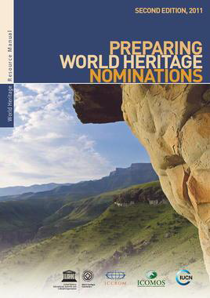
Suggested sequence for preparing a nomination
Background research
Comparative analysis
Draft Statement of OUV
Define relevant attributes
Assess authenticity and integrity
Define appropriate boundaries
Prepare description
Prepare history *
Complete dossier
UNESCO 2011. Preparing World Heritage Nominations..

Slide 58
KEY MESSAGE: The importance of the comparative analysis
Because of where it is discussed in the nomination dossier and other documents, might be seen as not that important.
CA is central to the nomination dossier – demonstrating why the property should be considered to have potential OUV.
This is set out when the property is put on the Tentative List, but detailed work should be an early task in developing a nomination…becomes the basis for the overall narrative
This can be presented as follows:
UNESCO 2011. Preparing World Heritage Nominations. Second edition

Slide 59
Identifying and defining potential OUV
Understand the values of the property and the World Heritage criteria that may apply to it
Carry out a Global Comparative Analysis to test the values of the property against comparable World Heritage and other properties selected on a worldwide basis
Confirm the criteria that should form part of the nomination and develop a Statement of Outstanding Universal Value
UNESCO 2011. Preparing World Heritage Nominations. Second edition

Slide 60
Nomination dossier – there is a defined format
Executive summary
1. Identification of the property
2. Description
3. Justification for inscription
• 4. State of Conservation and Factors affecting the property
• 5.Protection and Management of the Property
• 6.Monitoring
• 7.Documentation
• 8.Contact details
• 9.Signature on behalf of State Party
• Annexes
İlginiz için teşekkür ederim
UNESCO 2011. Preparing World Heritage Nominations. Second edition

Slide 61
3. Justification for Inscription
3.1a Brief Synthesis
3.1b Criteria under which Inscription is Proposed
3.1c Statement of Integrity
3.1d Statement of Authenticity
3.1e Protection and Management Requirements
3.2 Comparative Analysis
3.3 Proposed Statement of Outstanding Universal Value

Slide 62
4. State of Conservation and Factors Affecting the Property
4.a Present State of Conservation
Inventories, recording, research
The following need to be addressed:
Has the property been inventoried? Described? Documented?
When has this been done?
Does the nomination provide evidence of this work?
Can this been used as baseline date for the future?
Active conservation measures
Active conservation measures: conservation actions and programmes and maintenance .
The following need to be addressed:
Are the conservation measures appropriate ones to preserve values, authenticity and integrity?
Are they programmed?
Do they fit into a global approach (or are they 'patchy')?
Is there regular maintenance?
Is there funding to implement conservation work (when needed) and maintenance?
Are the works carried out by persons with the correct level of skill and expertise?
Are there any urgent measures to take? Is there funding to implement them?

Slide 63
4.B Factors affecting the property
Development pressures
Environmental pressures
Natural disasters and risk preparedness
Responsible visitation at World Heritage sites

Slide 64
5. Protection and Management of the Property…all components
5.a Ownership
5.b Protective Designation
5.c Means of Implementing Protective Measures
5.d Existing Plans Related to Municipality and Region in which the Proposed Property is Located
5.e Property Management Plan or Other Management System
5.f Sources and Levels of Finance
5.g Sources of Expertise and Training in Conservation and Management Techniques
5.h Visitor Facilities and Infrastructure
5.i Policies and Programmes Related to the Presentation and Promotion of the Property
5.j Staffing Levels and Skills and Expertise

Slide 65
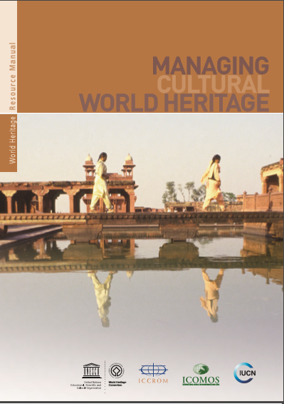
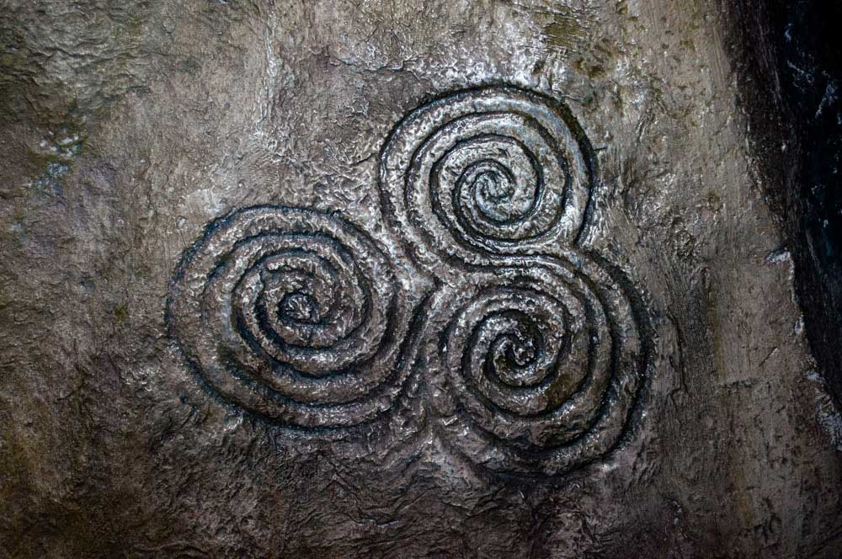
KEY: A Management System needed
e.g.Brú na Bóinne represents the most complex management scenario example in the World Heritage Manual
A variety of entities involved in management of the property as well as the buffer zone
FROM: MCWH 2013
Notes:
Brú na Bóinne represents the most complex management scenario example in the World Heritage Manual
A variety of entities involved in management of the property as well as the buffer zone
Distributing responsibility
good definition, implementation and maintenance of procedures, roles, responsibilities
A clear assignment of personal responsibility to all individuals involved is particularly important to ensure accountability and also transparency

Slide 66
Annexes to the Dossier
Additional information
Crucially should include:
Detailed and current Management Plan
Detailed Conservation Plan
Risk Preparedness Plan
Visitor and Tourism Management Plan
Research strategy/framework (how does this link with the Conservation Plan)

Slide 67
ICOMOS EVALUATION
Evaluation procedure
Nominations
↓
UNESCO
↓
ICOMOS
↓
World Heritage Group
↓
Desk Assessors + Mission + Desk Assessors
(expert from the region)
↓
ICOMOS Panel – includes consultation with State Party
↓
World Heritage Committee
Rigorous and institutional evaluation
Accompanied by clear policy to avoid perceptions of conflict of interest
Notes:
The ICOMOS evaluation is designed to ensure that a rigorous and institutional evaluation occurs.
The process is accompanied by policy to avoid perceptions of conflict or interest. This policy is available on the ICOMOS website.

Slide 68
World Heritage Committee…current thinking on the nomination process (DECISION 43 COM 12)
Approved the concept of a two-phase nomination process
Preliminary Assessment – desk study
Second stage - Full Assessment
Aim:
Assist State Party in deciding whether or not to pursue a nomination
State Party focusing investment of resources on nominations with high inscription potential.
NOTE – The Upstream Process (voluntary) can be used to promote early dialogue between State Parties and the Advisory Bodies about Tentative List and prospective nominations.

Slide 69
Note to teams….
•Start with an approved, practical and comprehensive project plan
•All concerned parties must be represented
•WH nomination must not be the only objective
•Project leader who needs a clear mandate
•Early agreements to avoid late disagreements (and additional costs)
•Built public support; connect, find a ‘standard bearer’
•One voice in communication
•Give all parties credit
(Dré Van Marrewijk 2013)

