Slide 1
World Heritage Tentative List Workshop No 2
INTRODUCTION from ICOMOS (Ireland)
Gráinne Shaffrey
President ICOMOS Ireland
18 June 2020
.

Slide 2
Introduce the ICOMOS Ireland team
Context for Workshops
Reminder of ICOMOS role and relationships with UNESCO World Heritage Centre and WH Process
Questionnaire – some observations
Key messages

Slide 3
ICOMOS IRELAND MEMBERS PRESENT
Mona O’Rourke
Grellan Rourke
Willy Cumming
Deirdre McDermott
Gillian Lattimore
Gráinne Shaffrey
(Gabriel Cooney)

Slide 4
Context for Workshop
Evolution from Killarney Pilot Workshop
Learning from Killarney Workshop and Questionnaire findings
Focus on specific themes arising:
Mona: Communicating and Demystifying the World Heritage System
Grellan: some fundamental concepts – particularly with regard to Comparative Analysis; Boundaries and Buffer Zones; Serial Nominations
Reference documents and sources previously issued by ICOMOS Ireland

Slide 5
ICOMOS is one of 3 Advisory Bodies to the UNESCO World Heritage Centre

Slide 6
STATE PARTIES
107 National Committees
PROPERTIES / WHS
28 ISCs + 4 WGs

Slide 7
QUESTIONNAIRE –
Key Challenges identified
Community / Stakeholders - multiple stakeholders (support of stakeholders, landowners, partners, differing local issues, ensuring continued support of stakeholders through lengthy process of WHS nomination).
Organisational structures – who leads
Serial nomination / transnational nomination
Defining the site boundaries
Management - Management Planning; Resources; Effective management
Resources (human and financial) to fully progress to World Heritage Site status / to protect and sustain the Outstanding Universal Value
Unclear re level of resources (financial and expertise) available to assist county councils and state bodies in developing site nominations.

Slide 8
QUESTIONNAIRE –
Issues to be addressed in workshop
Serial Nominations – specific considerations, including transboundary, managing a bid with multiple stakeholders
Management Plan – key elements
Upstream process
Advice on supports/resources available in preparing application and after
Advice where significant development proposals in process
Discussion on benefits of WHS

Slide 9
QUESTIONNAIRE –
Summary of needs identified
Advice- support role of Dept and role of LA and other bodies
A National Policy and Guidelines for World Heritage
Resources and technical assistance for Nomination Dossiers and Management Plans
Management Plans as key elements in content
Organisational and management arrangements especially for Serial Nominations
Serial Nominations (including question of leadership)
Transnational Nominations alignment between jurisdictions
Drawing up Boundaries and identification of Buffer Zones
Stakeholder engagement especially for serial nominations
Discussion of benefits of World Heritage Status and any case studies
Opportunities to learn from one and other

Slide 10
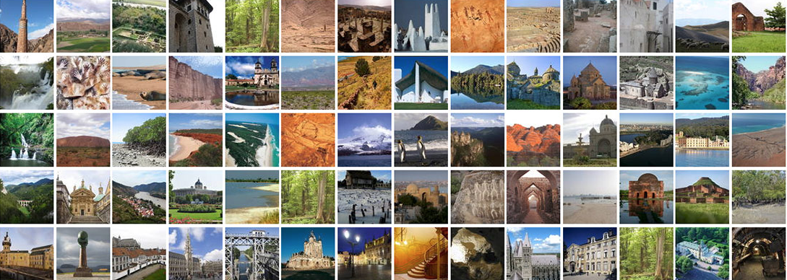
World Heritage seeks to encourage the identification, protection and preservation of cultural and natural heritage around the world considered to be of outstanding value to humanity.
What makes the concept of World Heritage exceptional is its universal application. World Heritage sites belong to all the peoples of the world, irrespective of the territory on which they are located
(www.whc.unesco.org )

Slide 11
SOME KEY MESSAGES
Complex concepts involved – these workshops provide a high-level overview
World Heritage = Local Heritage
World Heritage is a Process – requires momentum
Dimensions of Heritage – broad & need multi-/inter-/trans-disciplinary approaches and inputs
Expertise – stakeholder engagement – relationship building
Management is fundamental and multi-stranded

Slide 13
QUESTIONNAIRE –
Challenges identified
Organisational structures – e.g who leads
Community / Stakeholders - multiple stakeholders (support of stakeholders, landowners, partners, differing local issues, ensuring continued support of stakeholders through lengthy process of WHS nomination).
Serial Nominations – managing multiple stakeholders and general complexities
Boundaries –defining
Resources & Funding
Management Plans – resources and effective management
Maintaining Momentum

